Slide 1
Crystal-induced arthritis
Mustafa Al-Badran
CABM FIBMS
Notes:
NOTE:
To change the image on this slide, select the picture and delete it. Then click the Pictures icon in the placeholder to insert your own image.

Slide 2
Gout it is derived from the Latin word gutta, meaning "a drop" (of liquid) that flow in the joint causing the disease

Slide 3
the disease of kings" "rich man's disease"

Slide 4
The ancient Greeks personified gout as podagra, a child of Dionysus (god of wine) and Aphrodite (goddess of love(

Slide 5
Gout
The most common inflammatory arthritis in men and in older women
It is caused by deposition of monosodium urate monohydrate crystals in and around synovial joints

Slide 6
Epidemiology
The prevalence of gout is 1–2%, with a greater than 5 : 1 male dominance
Gout has become progressively more common over recent years due to the increased prevalence of obesity and metabolic syndrome

Slide 7
Pathophysiology
About one-third of the body uric acid pool is derived from dietary sources and two-thirds from endogenous purine metabolism
The concentration of uric acid in body fluids depends on the balance between endogenous synthesis, and elimination by the kidneys (two-thirds) and gut (one-third)
Purine nucleotide synthesis and degradation are regulated by a network of enzyme pathways, but xanthine oxidase plays a pivotal role in catalyzing the conversion of hypoxanthine to xanthine and xanthine to uric acid

Slide 9
Causes of hyperuricaemia and gout
1. Diminished renal excretion
• Increased renal tubular reabsorption (genetically determined)
• Renal failure
• Alcohol
• Drugs {Thiazide and loop diuretics, Low-dose aspirin, Ciclosporin, Pyrazinamide}
2. Increased intake (Red meat, Sea food)
3. Increased production
• Myeloproliferative and lymphoproliferative disease
• Psoriasis
• High fructose intake
Notes:
Over activity of phosphoribosylpyrophosphate (PRPP) synthetase
Partial deficiency of hypoxanthine–guanine phosphoribosyltransferase (HGPRT) (Kelley-Seegmiller syndrome)
Complete HGPRT deficiency results in Lesch-Nyhan syndrome Mental retardation Spasticity Choreoathetosis Self-mutilation
The correlation of Alcohol consumption with hyperuricemia and gout Consuming over 30 to 50 g of alcohol a day (three to four beers, glasses of wine, or liquor shots ) الخمورincreases gout risk by 2 to 2.5-fold Alcohol consumption increases urate synthesis by o Accelerating the hepatic ATP catabolism o Lactate production Beer contains a substantial amount of Guanosine (Purine) and confers a >2-fold risk of gout over liquor. Moderate wine consumption not increase serum urate or gout risk. Patient with established gout, episodic consumption of all alcohol types (wine, beer, and liquor) increases the risk of recurrent flare in a dose-dependent fashion

Slide 10
The risk of developing gout increases with age and with serum uric acid (SUA) levels
SUA levels are higher in men, increase with age and are positively associated with body weight & Levels are higher in some ethnic groups (such as Maoris and Pacific islanders)
Although hyperuricaemia is strong risk factor for gout, only a minority of hyperuricaemia individuals actually develop gout

Slide 11
Notes:
الماوري هم السكان الأصليون لنيوزيلندا وجزر كوك

Slide 12
Clinical features
The classical presentation is with an acute Monoarthritis (1st MTP joint in over 50%)
Other common sites are the midfoot, ankle, knee, small joints of hands, wrist and elbow

Slide 13
Typical features include
Rapid onset, reaching maximum severity in 2–6 hours, and often waking the patient in the early morning
Severe pain ‘worst pain ever’
Extreme tenderness(the Patient is unable to wear a sock or to let bedding rest on the joint)
Marked swelling with overlying red, shiny skin
Self-limiting over 5–14 days(complete resolution)

Slide 14
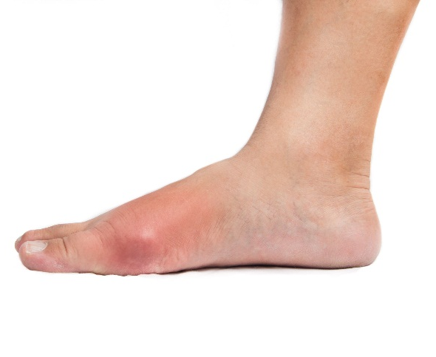

Slide 16
Fever, malaise and even delirium, if a large joint such as the knee is involved
Pruritus and desquamation of overlying skin as the attack subsides
The main differential diagnosis is
Pseudogout
Septic arthritis
Infective cellulitis
Reactive arthritis

Slide 18
Usually ,a second attack occurs within 1 year and may progress to chronic gout
The presentation of gout in the elderly may be atypical with chronic symptoms rather than acute attacks

Slide 19
Chronic Gout
Tophi: irregular firm nodules due to MSU Crystals deposition in the joints and soft tissues
Present in extensor surfaces of fingers, hands, forearm, elbows, Achilles tendons and the helix of the ear
Tophi have a white colour and can ulcerate, discharging white gritty material, become infected or induce a local inflammatory response, with erythema and pus in the absence of secondary infection

Slide 20
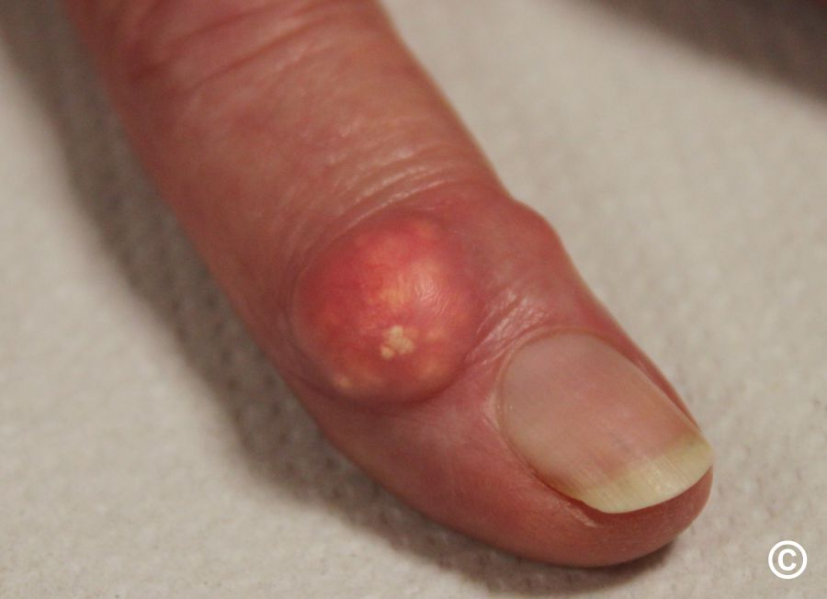
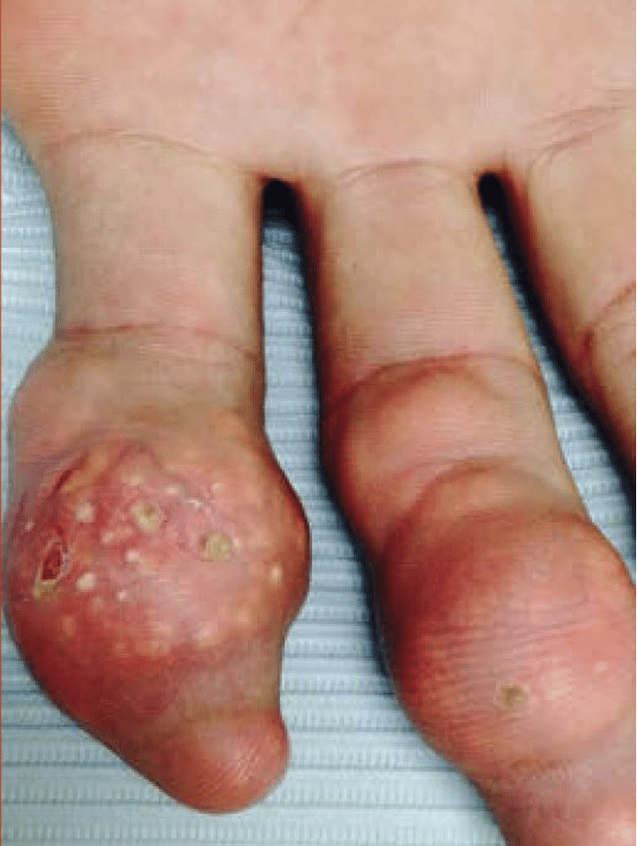

Slide 21
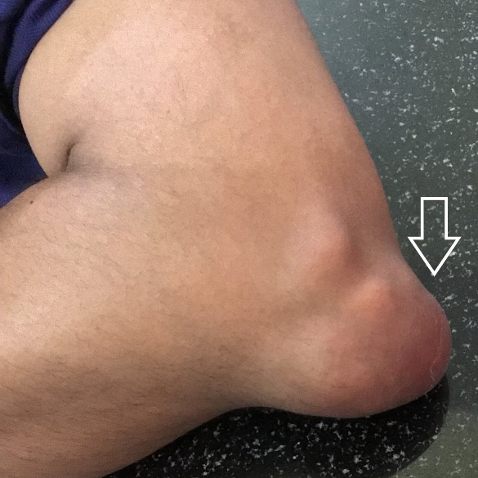
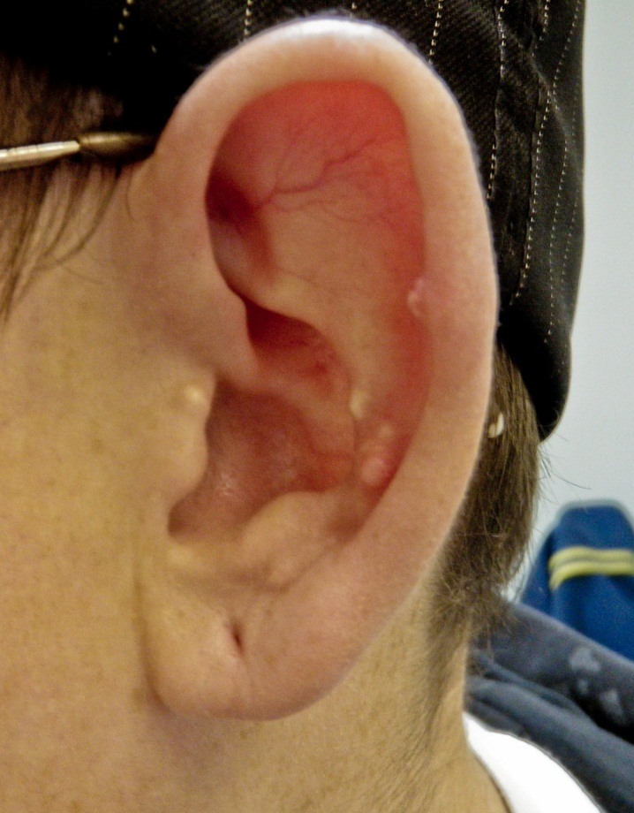
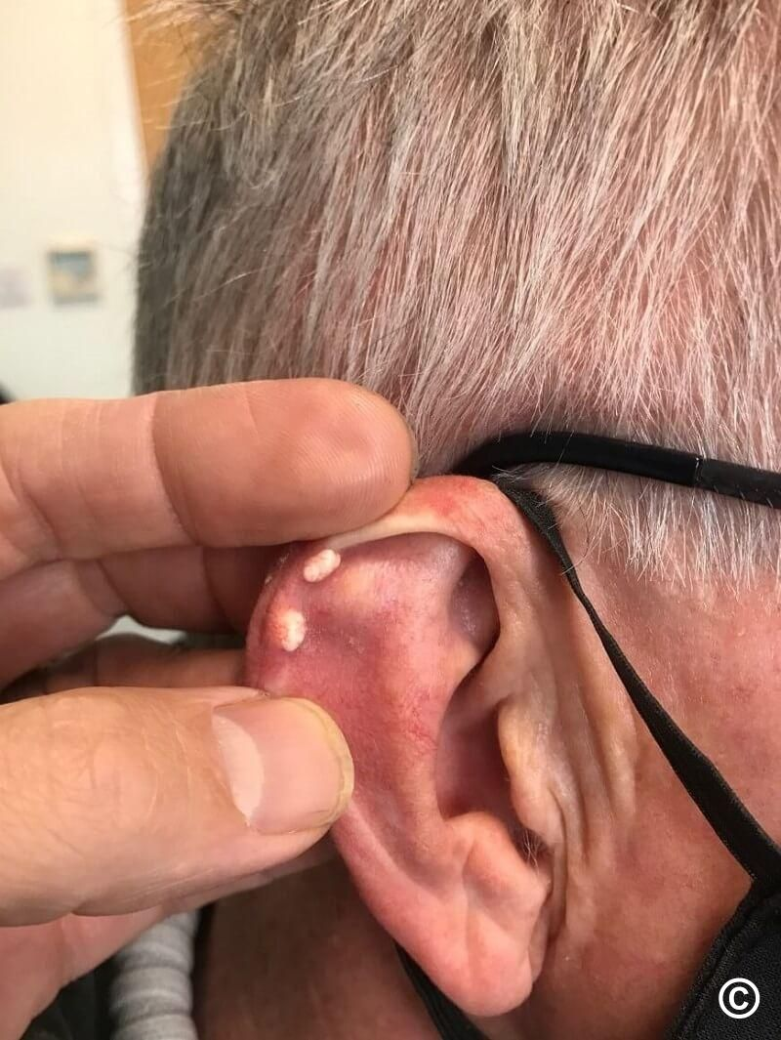

Slide 22
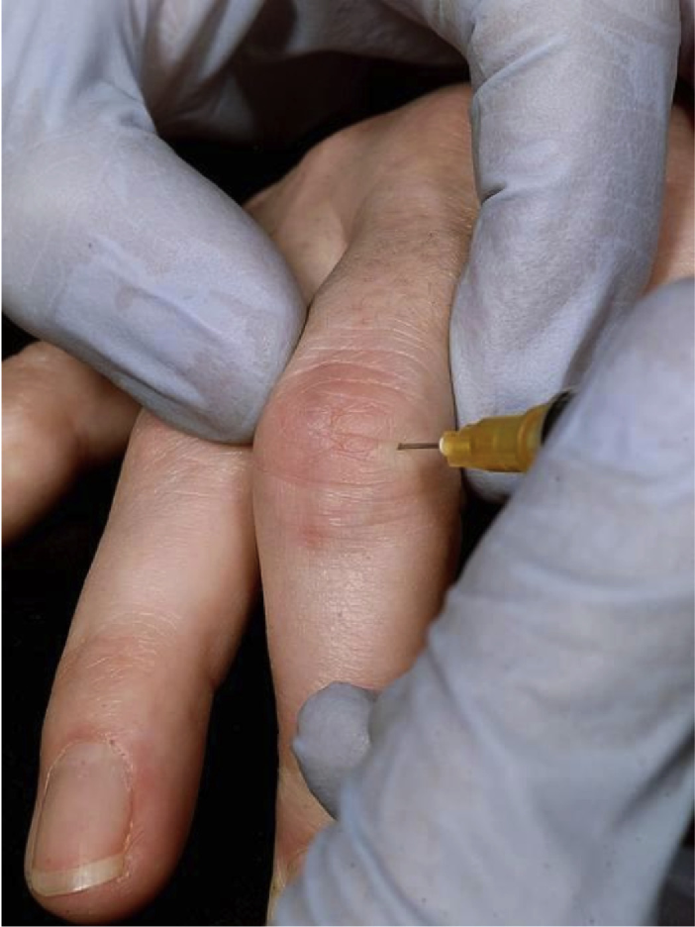
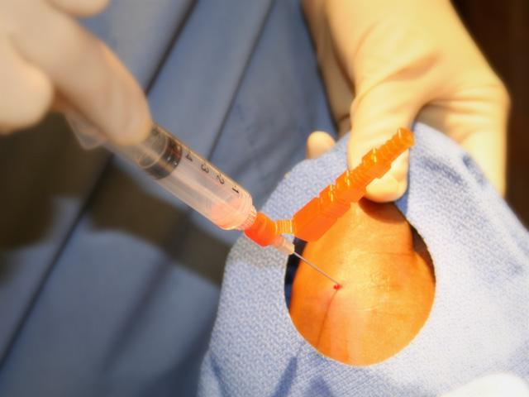
Investigations
The definite diagnosis confirmed by the identification of urate crystals in the aspirate from a joint, bursa or tophus

Slide 23
Under polarized light microscopy, MSU crystals have a needle-like morphology and strong negative birefringence

Slide 24
A biochemical screen, including renal function, uric acid, glucose and lipid profile(metabolic syndrome)
Serum urate falls during inflammation (?)
Acute gout accompanied by an elevated ESR and CRP and with a neutrophilia
Tophaceous gout accompanied by a modest but chronic elevation in ESR and CRP

Slide 25
X-rays
Normal in acute gout
Well demarcated erosions in chronic or tophaceous gout

Slide 26
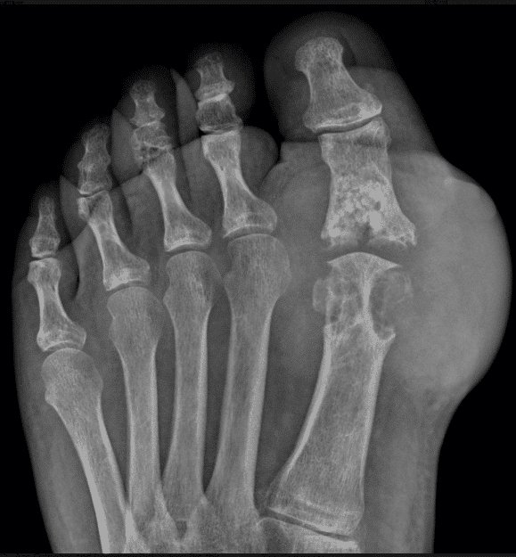
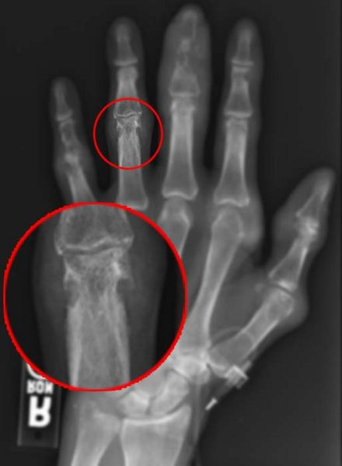

Slide 27
Management
Treat the acute attack
Prophylaxis to lower SUA and prevent further attacks

Slide 28
Acute gout
Local ice packs
Oral colchicine (First choice)
Doses of 0.5 mg twice daily
Inhibiting microtubule assembly in neutrophils
The adverse effects are nausea, vomiting & diarrhoea
Oral NSAIDs
Use with caution in patients with coexisting cardiovascular, cerebrovascular or chronic kidney disease

Slide 29
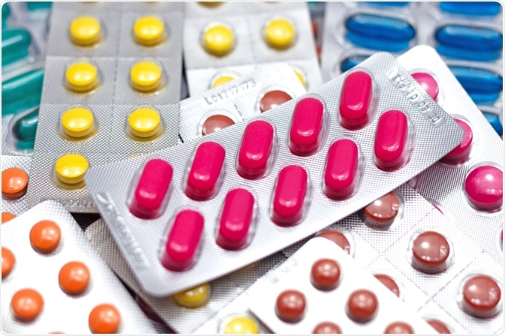

Slide 30
Corticosteroid
Oral prednisolone (15–20 mg daily) or
I.M methylprednisolone (80–120 mg daily) for 2–3 days
Highly effective
Good choice in elderly patients
IL-1β inhibitor (Canakinumab)
Effective
Extremely expensive

Slide 31
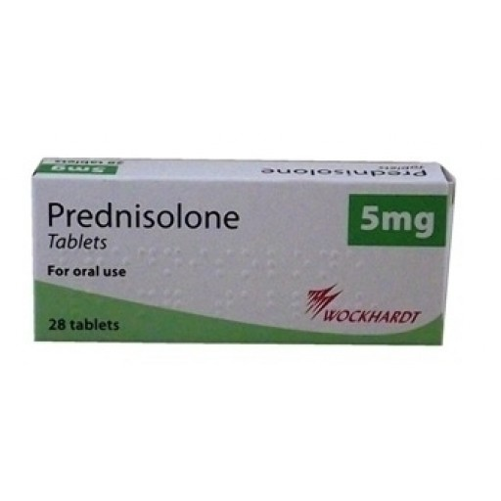

Slide 32
Patients with recurrent episodes can keep a supply of an NSAID, colchicine or prednisolone and take it as soon as the first symptoms occur, continuing until the attack resolves

Slide 33
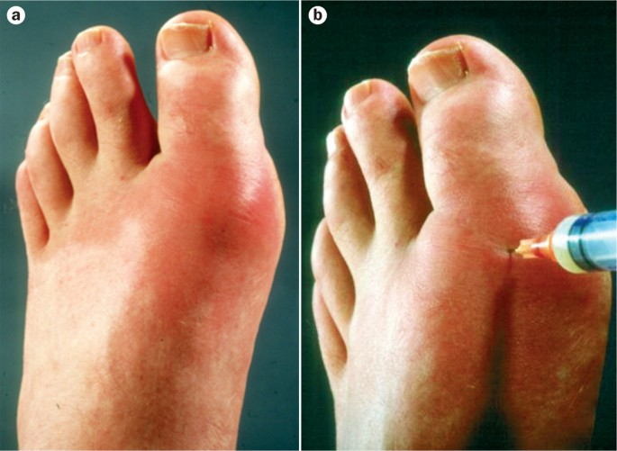
Joint aspiration
Pain relief (large joint is affected)
Combined with an intra-articular glucocorticoid injection (if the diagnosis is clear and infection can be excluded)

Slide 34
Prophylaxis
Indications Lifelong ULT is indicated for gout patients characterized by 1. Frequent flares(more than two flares over a 1-year) 2. Renal stones (urate or calcium) 3. Tophaceous gout (by examination or radiographically) 4. Moderate-to-severe CKD
A therapeutic target of 360 µmol/L (6 mg/dL) is recommended in the BSR guidelines, whereas the EULAR guidelines recommend a threshold of 300 µmol/L (5 mg/dL)

Slide 35
Allopurinol (the drug of first choice)
Inhibits xanthine oxidase, which reduces the conversion of hypoxanthine and xanthine to uric acid
The starting dose is 100 mg daily(50 mg in renal impairment)
The dose of allopurinol should be increased by 100 mg every 4 weeks until
Target uric acid level achieved
Side-effects occur
The maximum recommended dose is reached (900 mg/day)

Slide 36
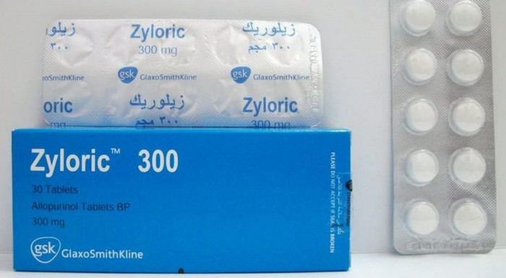

Slide 37
Acute flares of gout often follow initiation of urate lowering therapy →continue therapy
The risk of flares reduced by prophylaxis with oral colchicine (0.5 mg twice daily) or an NSAID for the first few months

Slide 38
Febuxostat
Inhibits xanthine oxidase
Used in patients with
Inadequate response to allopurinol
Allopurinol is contraindicated or causes adverse effects
No dose adjustment in renal impairment (Liver Metabolism)
More effective than allopurinol but commonly provokes acute attacks when therapy is initiated
Starting dose is 80 mg daily, increasing to 120 mg daily in patients with an inadequate response

Slide 40
Uricosuric drugs
Probenecid
Sulinpyrazone
Benzbromarone
They are contraindicated in
Over-producers
Renal impairment
Urolithiasis (Require high fluid intake to avoid uric acid crystallization in the renal tubules)

Slide 41
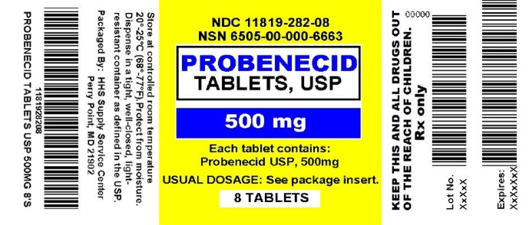
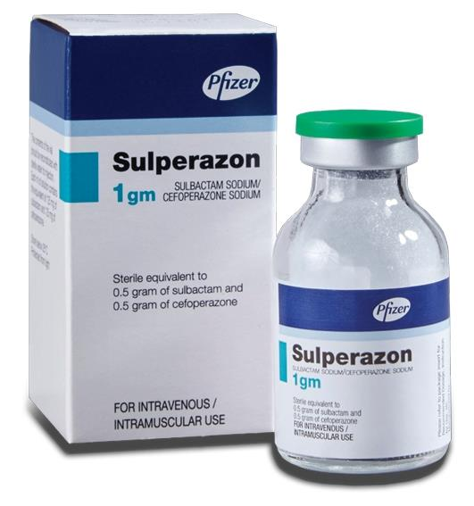

Slide 42
Pegloticase
Biological treatment in which the enzyme uricase (oxidizes uric to allantoin)
Indicated for the treatment of tophaceous gout resistant to standard therapy and is administered as an intravenous infusion every 2 weeks for up to 6 months
Adverse effects are
Infusion reactions (treated with antihistamines or glucocorticoids)
Flares of gout during the first 3 months of therapy
A limiting factor for longer-term treatment is the development of antibodies to Pegloticase, causing impaired therapeutic response

Slide 43
Lifestyle measures are equally important as drug therapy in the treatment of gout
Patients should be advised to
Lose weight
Reduce excessive alcohol intake, especially beer
Replace thiazides, β-blockers and ACE inhibitors(increase uric acid levels) with Losartan (has a uricosuric effect )
Avoid large amounts of seafood and offal (High purine content) but a highly restrictive diet is not necessary
Avoid sugar-sweetened beverages
Notes:
anchovies, shrimp, organ meat, dried mushrooms, seaweed, and beer yeast. Chicken and potatoes also appear related

Slide 46
Calcium pyrophosphate dihydrate crystal deposition disease (Pseudogout)
Deposition of calcium pyrophosphate dihydrate (CPPD) crystals within articular and hyaline cartilage
The knee (hyaline cartilage and menisci) is by far the most common site, followed by the wrist (triangular fibrocartilage) and pelvis (symphysis pubis)

Slide 47
Risk factors for chondrocalcinosis
Common
Age
Osteoarthritis
Primary Hyperparathyroidism
Less common
Familial factors
Haemochromatosis
Wilson’s disease
Hypophosphatasia
Hypomagnesaemia

Slide 48
The classical presentation of Calcium pyrophosphate dihydrate crystal deposition disease
Acute Pseudogout
Swollen tender joint with a large effusion usually uniformly blood-stained
Fever is common and the patient may appear confused and ill
Chronic CPPD arthropathy
Rheumatoid Like
Osteoarthritis like
Crowned dens syndrome
Inflammation around the odontoid process
Psudocharcot

Slide 49
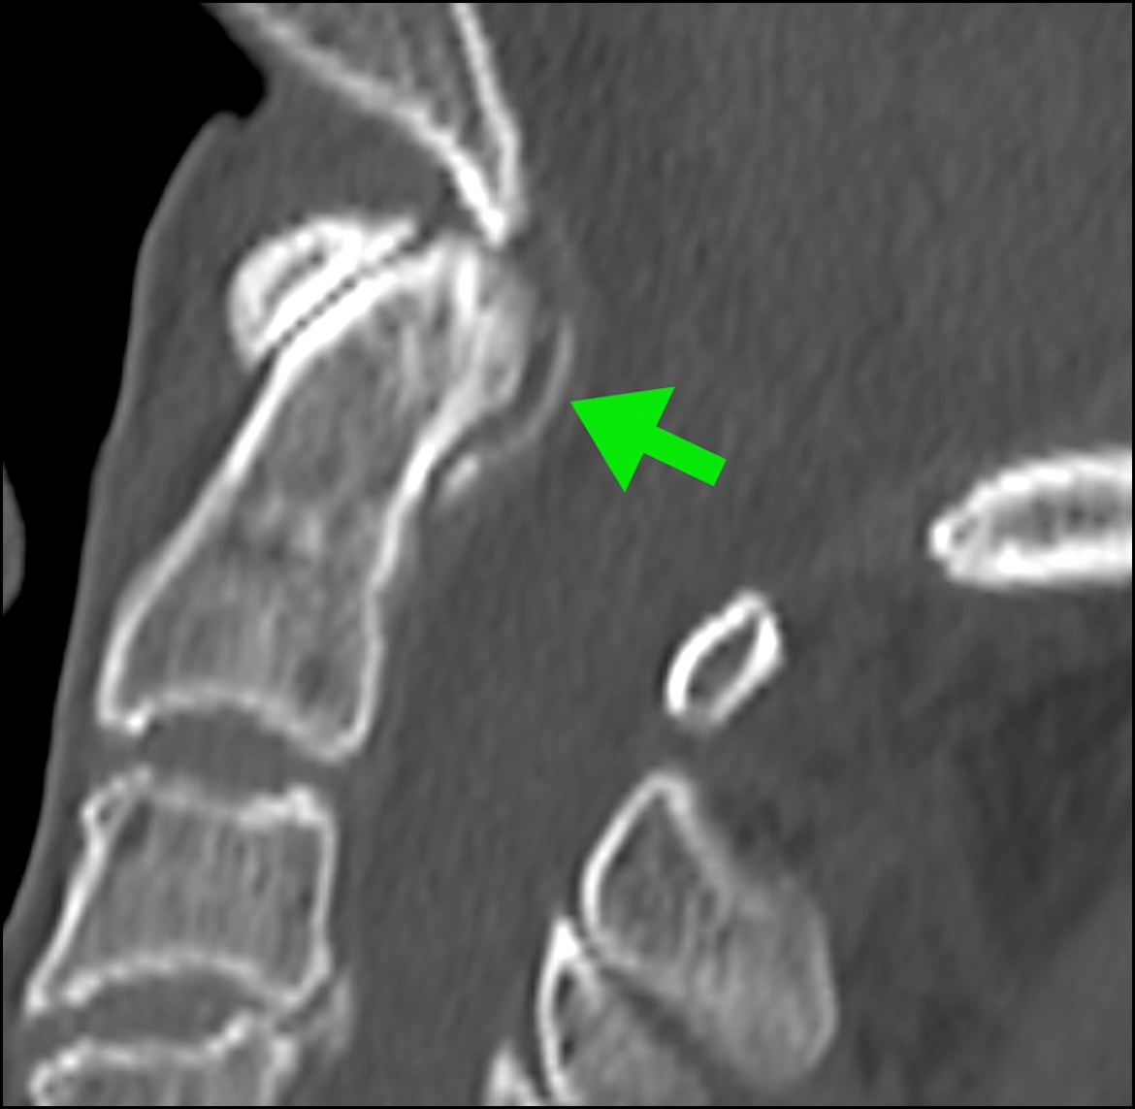
(A) Thin curvilinear calcification (arrow) of the transverse ligament of the atlas (B) Linear calcification (arrows) in the coronal view

Slide 50
Investigations
Joint aspiration, followed by compensated polarized microscopy to demonstrate CPPD crystals
Gram stain and culture of the fluid should be performed to exclude sepsis, even if CPPD crystals are identified

Slide 51
Compensated polarizing light microscopic findings CPPD crystal which appears rhomboid-shaped with triclinic structures and positive birefringent
Notes:
When the long axis of the crystal was parallel to the Z′ axis (parallel to the axis of the compensator), the color of the crystal was blue (A). When the long axis of the crystal was parallel to the X′ axis (perpendicular to the axis of the compensator), the color of the crystal was yellow.

Slide 52
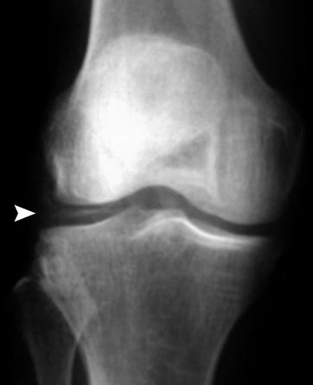
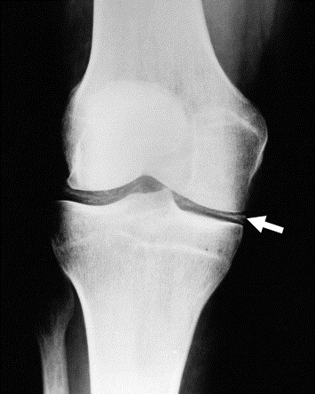
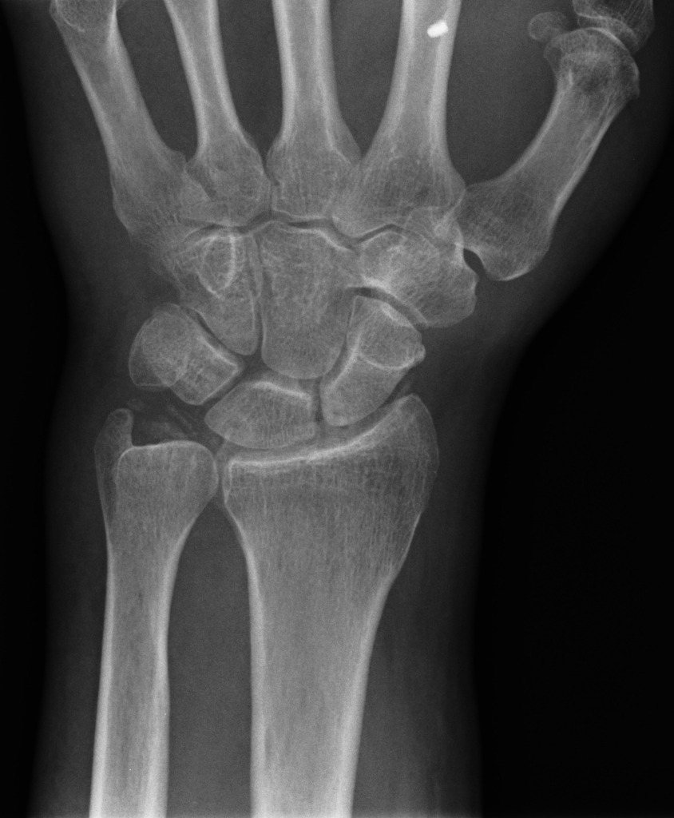
X-rays of the affected joint may show evidence of calcification in hyaline cartilage and/or fibrocartilage, (absence of calcification does not exclude the diagnosis)

Slide 53
Management
Joint aspiration (symptomatic relief and sometimes no further treatment is required)
Persistent symptoms can be treated with
Intra-articular glucocorticoid
Colchicine
NSAID
Chronic pyrophosphate-induced arthropathy should be managed as for OA

